Slide 1
Software Design and Architecture
Abstract Factory and Singleton Patterns

Slide 2
Design principles
High-level principles
‣ Single Responsibility
‣ Open/Closed
‣ Liskov Substitution Principle
‣ Interface Segregation
‣ Dependency Inversion
Low-level principles
‣ Encapsulate what varies
‣ Program to interfaces, not implementations
‣ Favor composition over inheritance
‣ Strive for loose coupling

Slide 3
Abstract Factory
Behavioral Patterns
observer
decorator
strategy
Creational Patterns
factory method
abstract factory

Slide 4
Problem
Too many dependencies to concrete classes makes your software diﬃcult to maintain and modify

Slide 5
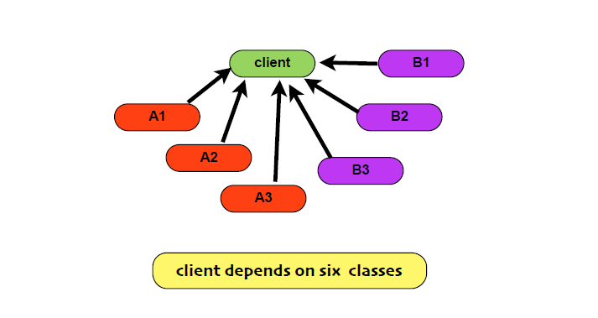
Example

Slide 6
Dependency Inversion principle
Depend upon Abstractions, do not
depend upon concrete classes

Slide 7


Slide 8
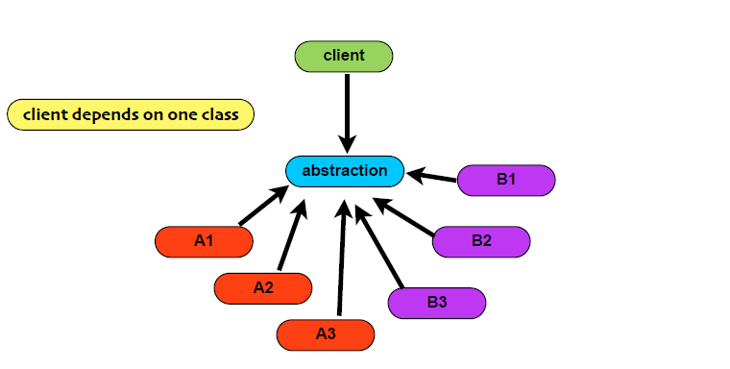
Factory Method

Slide 9
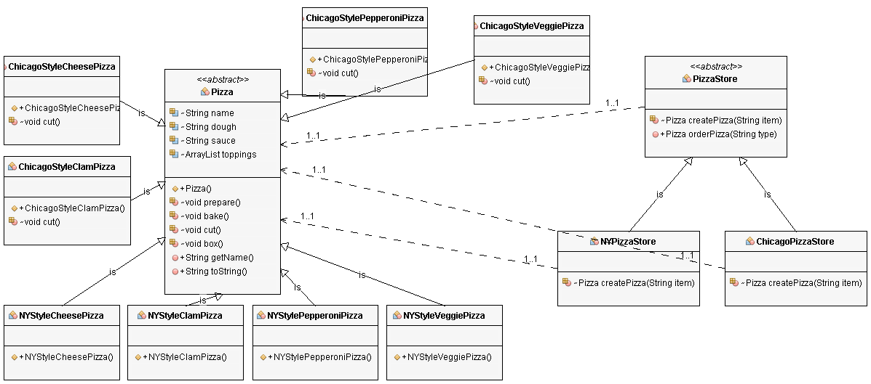
Factory Method
Factory Method is one way of following the dependency inversion principle
“Depend upon abstractions. Do not depend upon concrete classes.”
In this design, PizzaStore (the high-level class) no longer depends on the Pizza subclasses (the low level classes); they both depend on the abstraction “Pizza”.

Slide 10
Problem
There are different types of pizzas (Veggie, Clam, Cheese, and Pepperoni).
Different regions (NewYork and Chicago) use different types of ingredients for each type of pizza.

Slide 11
Guidelines
No variable should have a reference to a concrete class
No class should derive from a concrete class
No method should override an implemented method of any of its base classes.

Slide 12
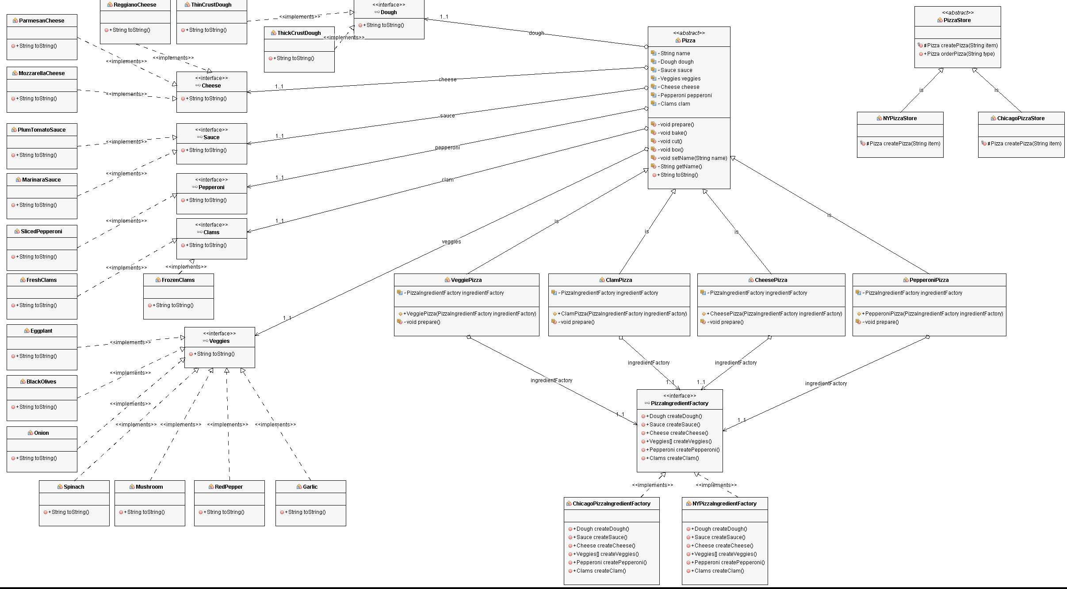
Abstract Factory

Slide 13
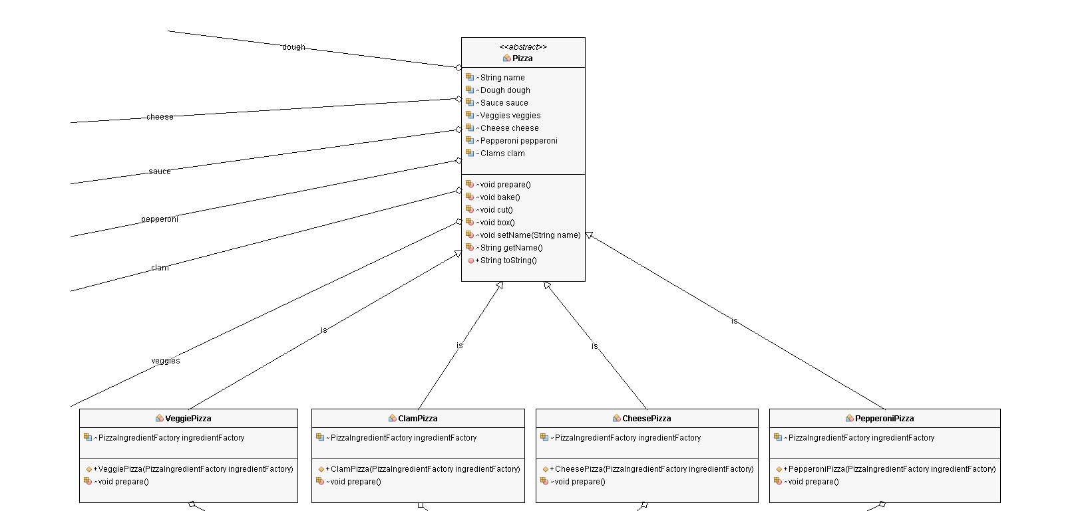
Four different types of pizzas

Slide 14
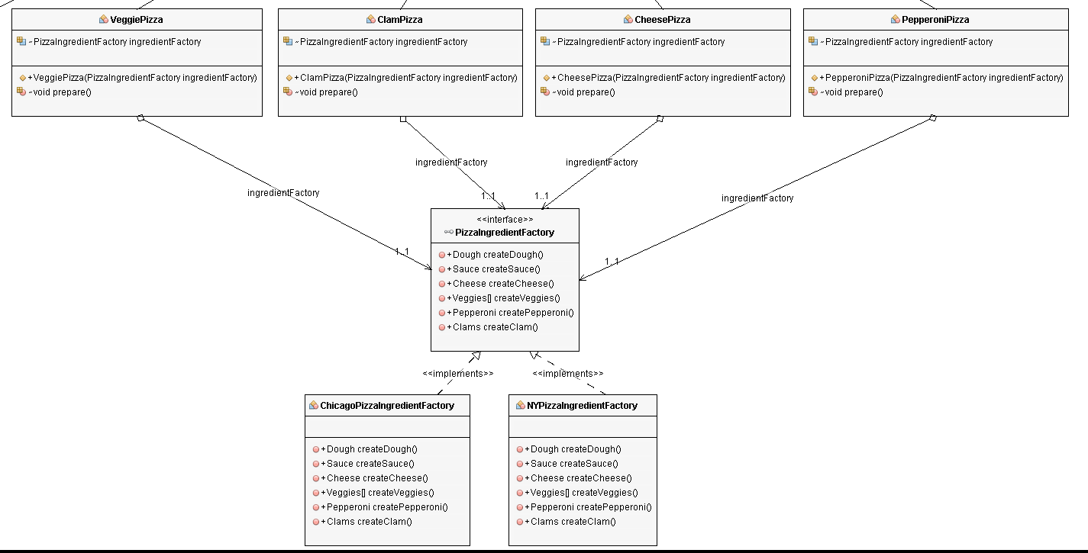
Region-specific ingredients

Slide 15
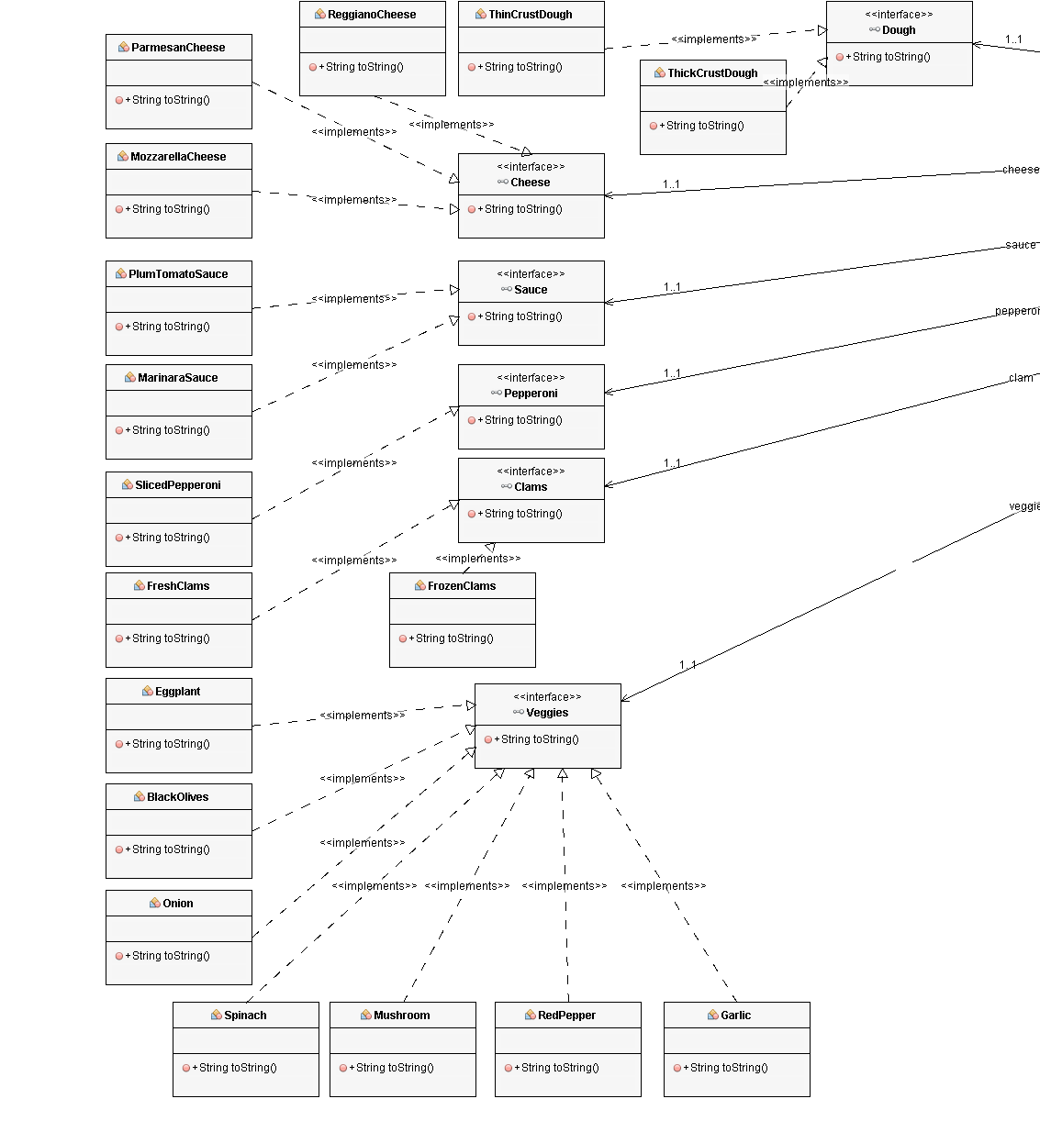
Ingredients

Slide 16
Ingredients
public interface Cheese {
public String toString();
}
public class MozzarellaCheese implements Cheese {
public String toString() {
return "Shredded Mozzarella";
}
}
public class ParmesanCheese implements Cheese {
public String toString() {
return "Shredded Parmesan";
}
}
public class ReggianoCheese implements Cheese {
public String toString() {
return "Reggiano Cheese";
}
}

Slide 17
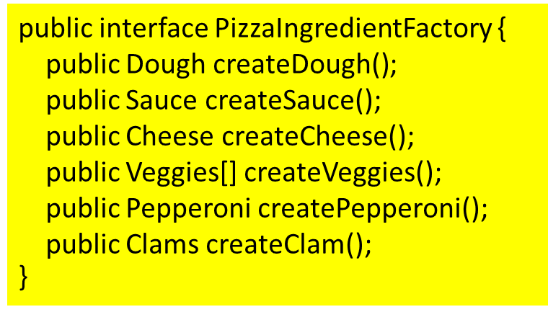
A Factory Interface

Slide 18
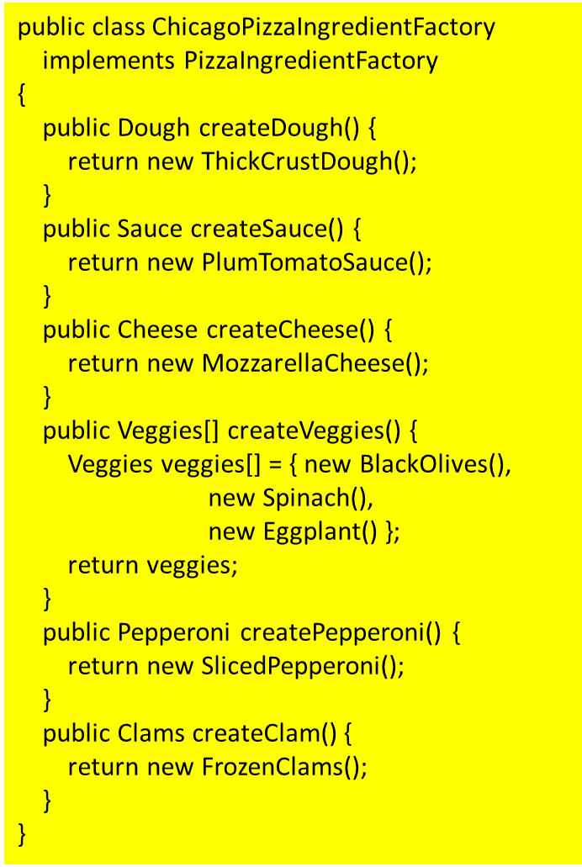
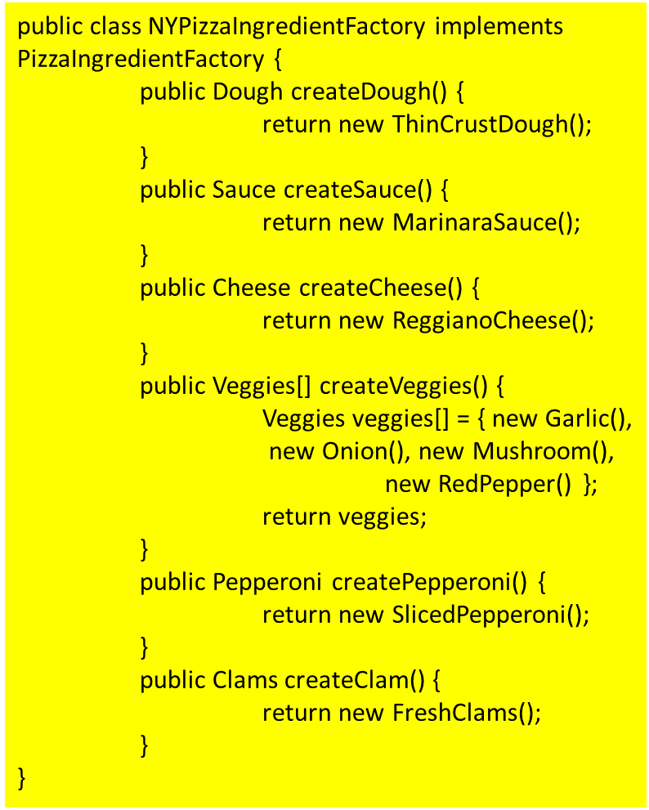
A Region-Specific Factory

Slide 19
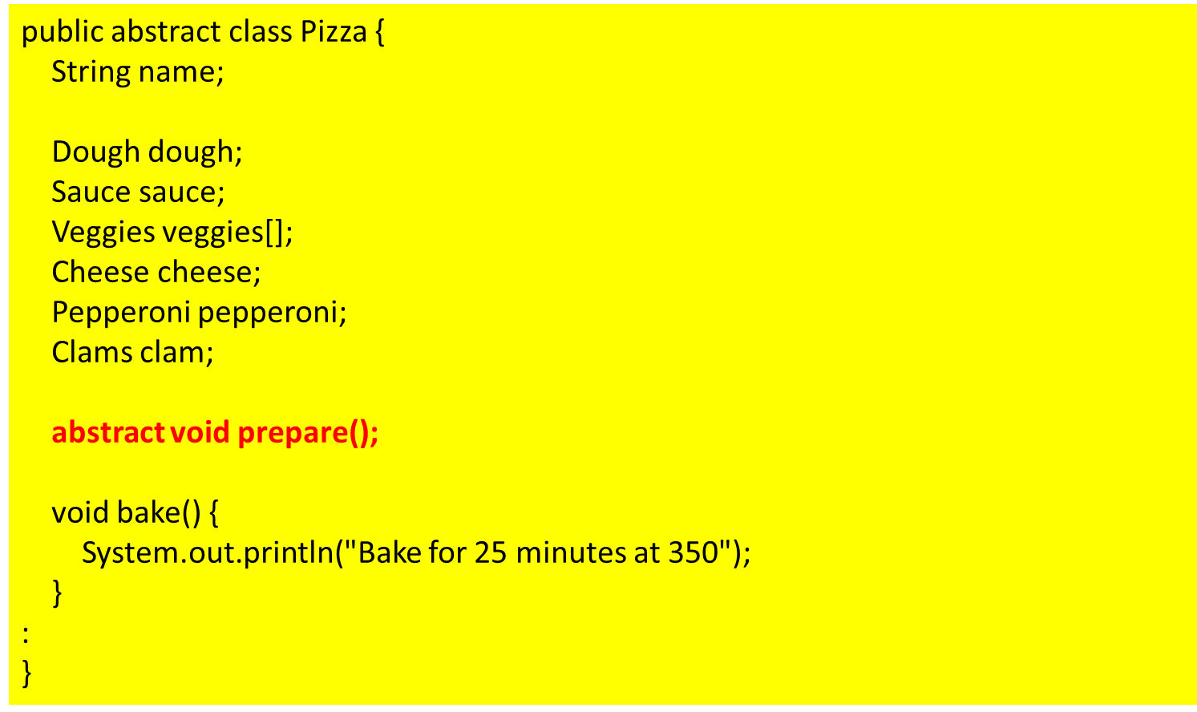
A Pizza Class
We make the prepare method abstract

Slide 20
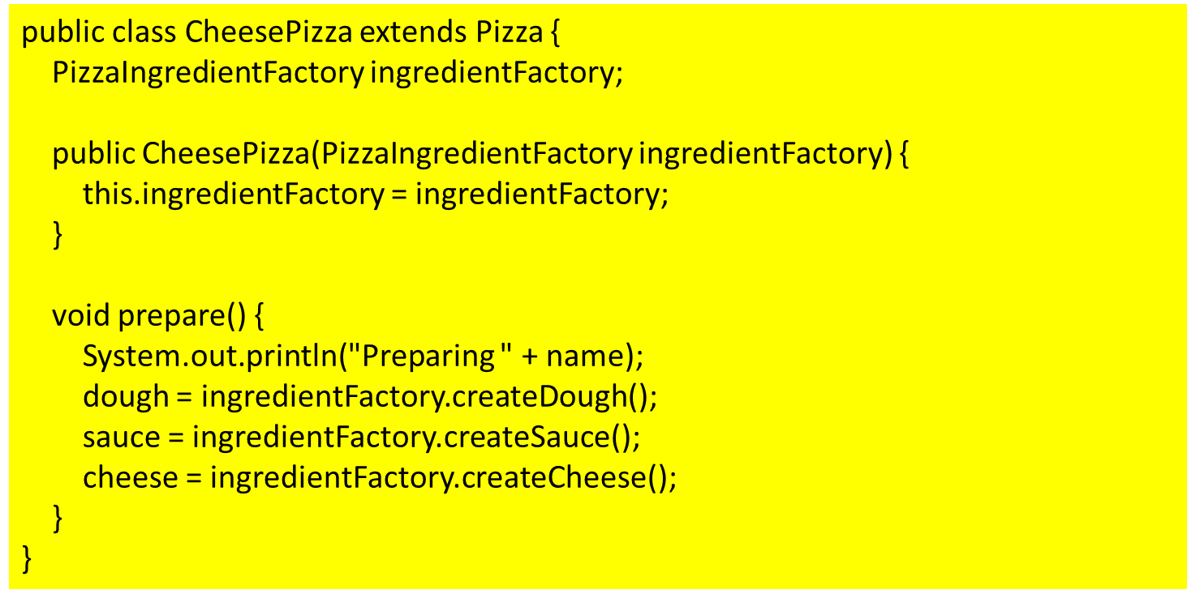
A CheesePizza Class

Slide 21
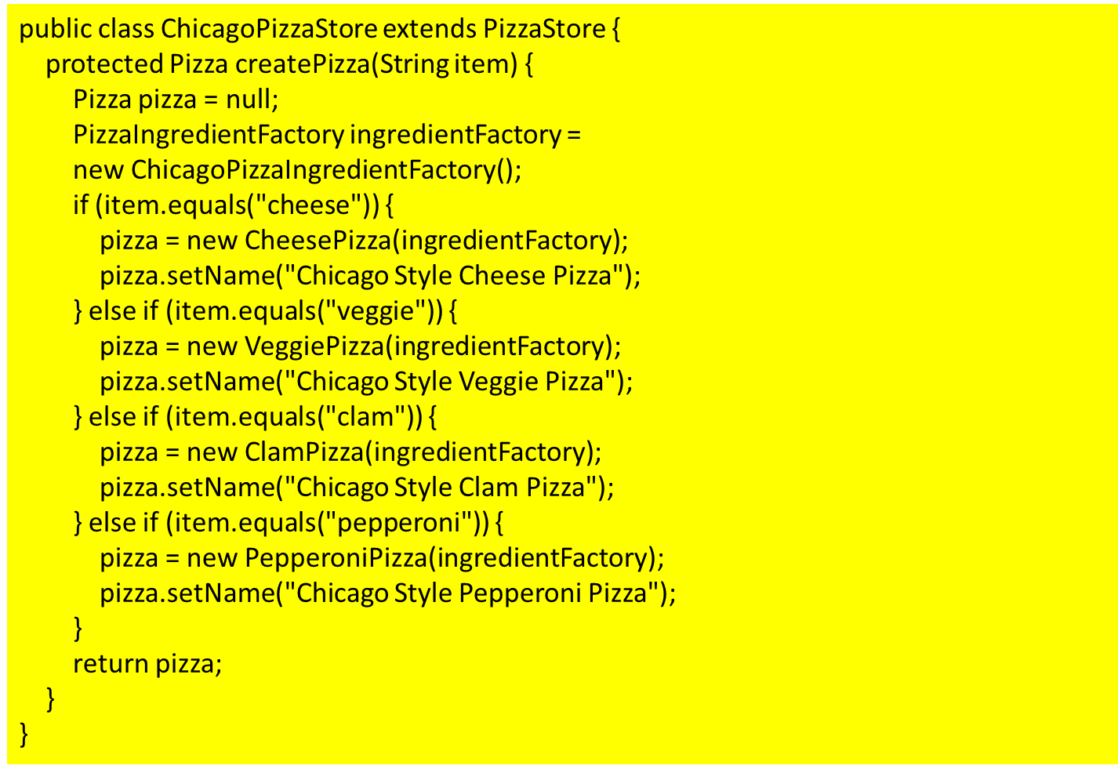
Region Specific Stores

Slide 22
Abstract Factory Pattern
The Abstract Factory Pattern provides an interface for creating families of related or dependent objects without specifying their concrete classes.

Slide 23
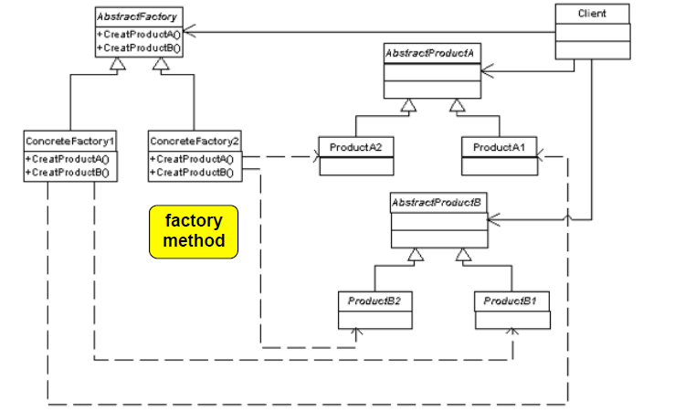
Abstract Factory Pattern

Slide 24
Singleton
Behavioral Patterns
strategy
observer
decorator
Creational Patterns
factory method
abstract factory
singleton

Slide 25
Problem
Some classes only need to be
instantiated once otherwise you
get incorrect behavior, overuse
of resources and inconsistent
results

Slide 26
Singleton
Singleton ensures a class has
only one instance, and provides a
global access point to it.

Slide 27
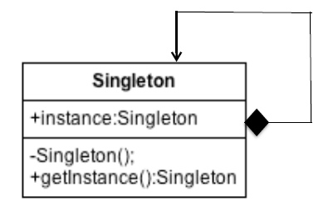
Class Diagram

Slide 28
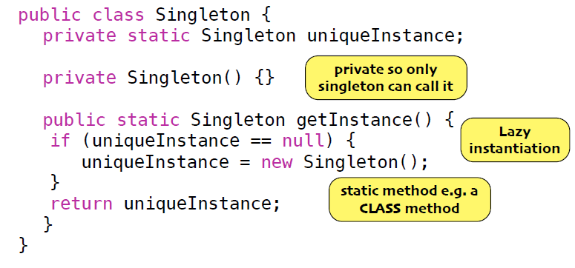
Solution

Slide 29
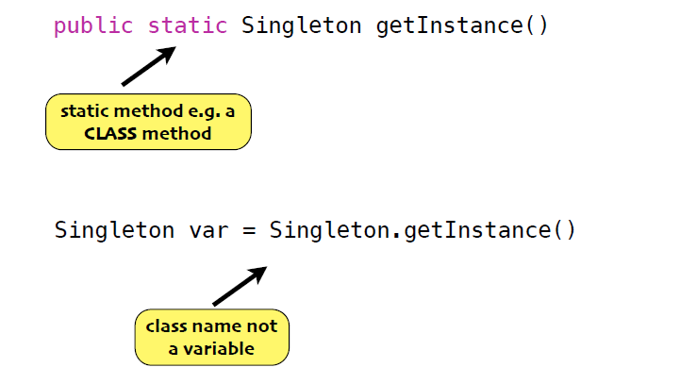
How to instantiate Singleton?

Slide 30
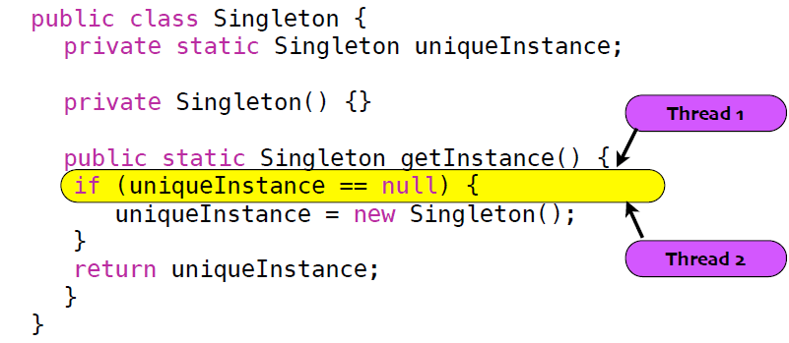
Problem: Not Thread Safe

Slide 31
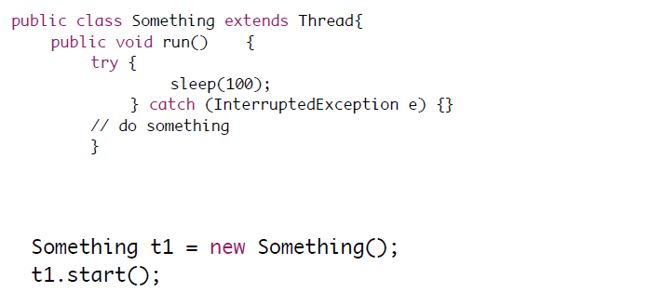
Thread Example

Slide 32
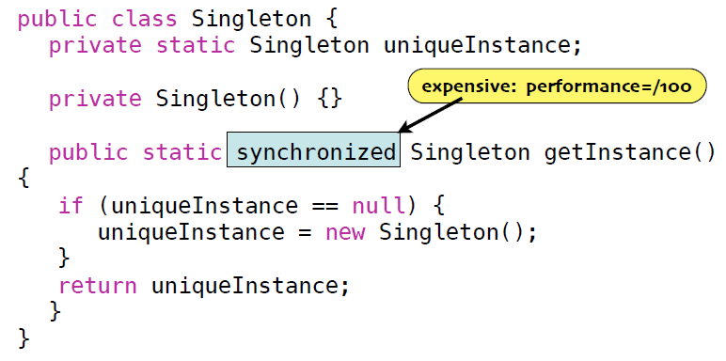
Solution 1: Add Synchronized

Slide 33
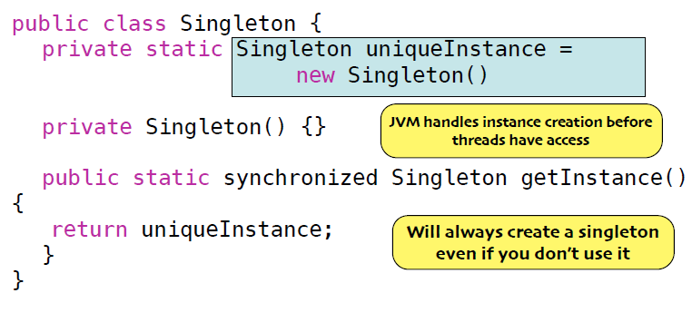
Solution 2: Create Eager Instance

Slide 34
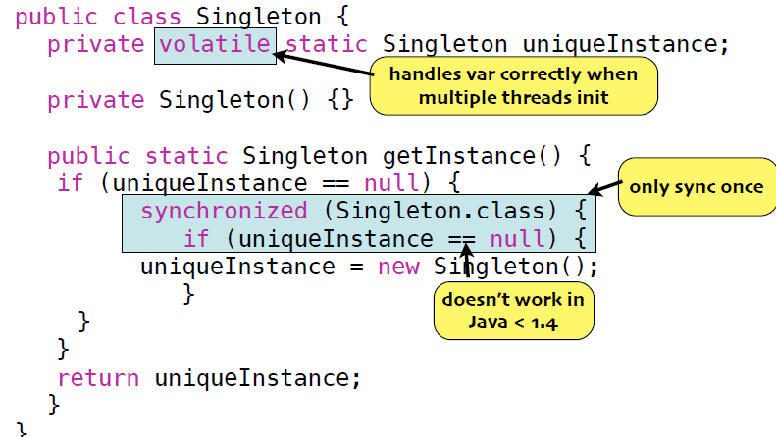
Solution 3: Double Checked Locking

Slide 35
Volatile
The value of this variable will never be cached
every read of this variable will be read from the main memory, and not from the CPU cache
every write to this variable will be written to main memory, and not just to the CPU cache
Access to the variable acts as though it is enclosed in a synchronized block, synchronized on itself

Slide 36
Benefits Singleton
Ensures you only at most have one instance
Provides global access point
Examine your performance requirements to determine which implementation of the singleton works best.
Some implementations don’t work with older version of Java

Slide 37

Example

Slide 38
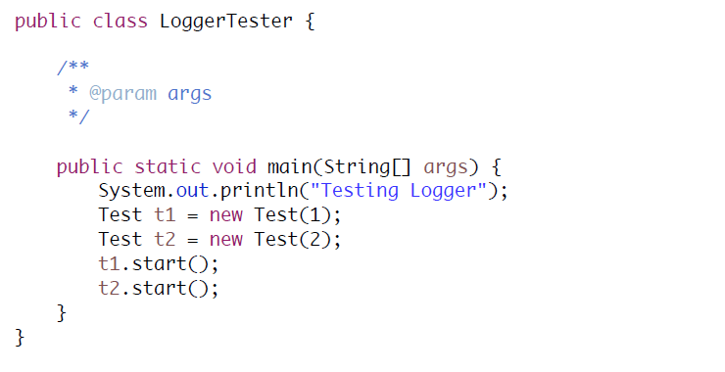
Main Application

Slide 39
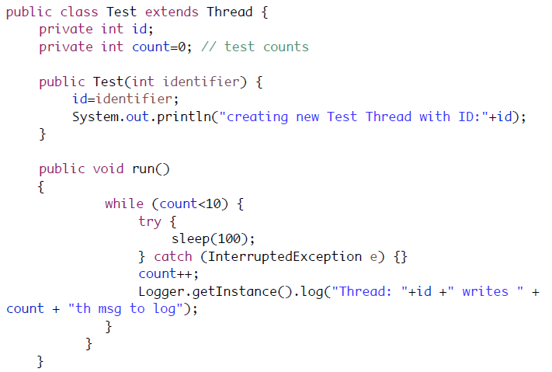
Test Class

Slide 40
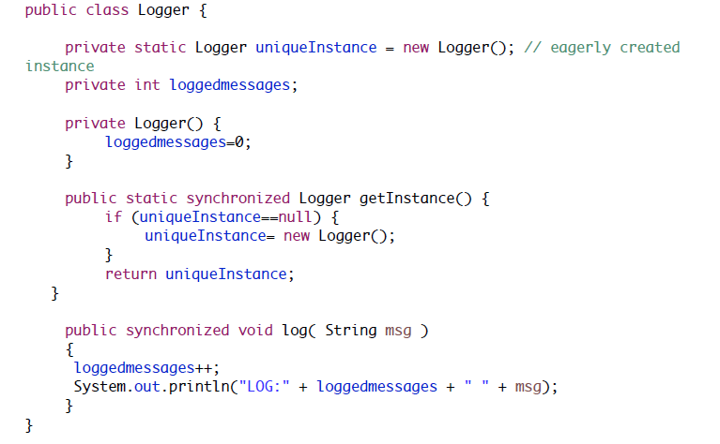
Logger Class

